Slide 1

DRESS ATTRIBUT SALE DATA CLASSIFICATION
Group 12:-
Himanshu Pandey(20)
Nishant bhat(41)
bhargav pawar(46)
shyam kawale(27)
AbhijIt gawai(18)

Slide 2
PROBLEM STATEMENT
Take Dresses_Attribute_Sales Data Set present in UCI repository and Find the correlation of the input features among them self and with target.
Find the different conclusions you got after data analysis of features.
Implement any classification algorithm to do classification of records.

Slide 3
INTRODUCTION
Dress attribute dataset gives us an idea about the recommendation for a particular dress on the basis of various factors such as dresstype, sleevline,waiseline,price, etc.
So this projects aims to find correlation between these attributes of the data set. And classify the datapoints into two classes recommended or not.

Slide 4
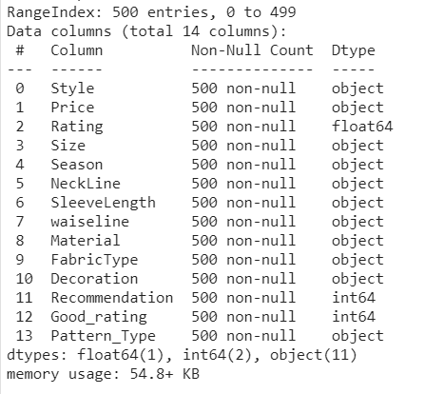
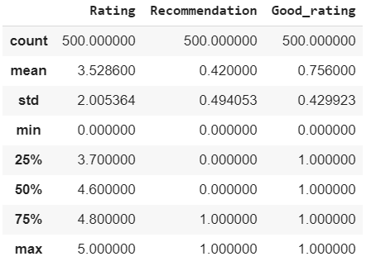
DATA ANALYSIS

Slide 5
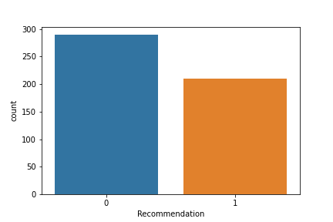
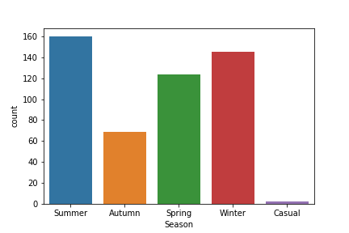
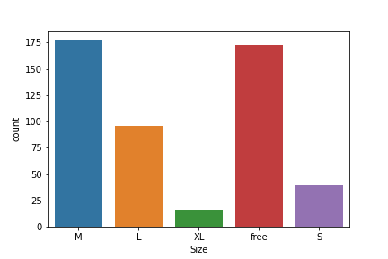
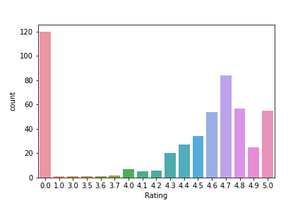

Slide 6
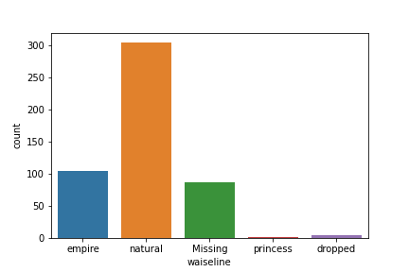
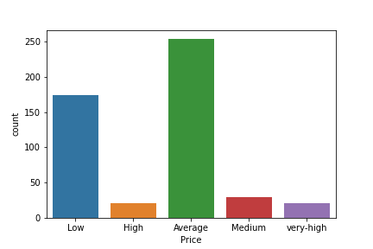
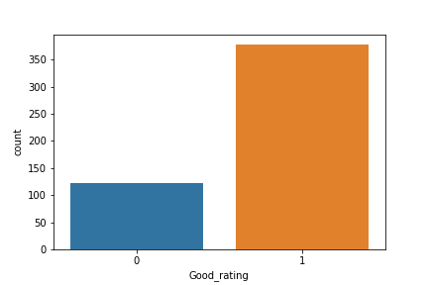

Slide 7
CORRELATION
Since our data set have a lot of categorical features so for finding the correlation between categorical features there are various ways, for example, chi square test, cramers_v, etc. Here we have used cramers_V.
For correlation between categorical and numerical we have used theils_u.
For correlation between numerical and numerical we have used pearson.

Slide 8
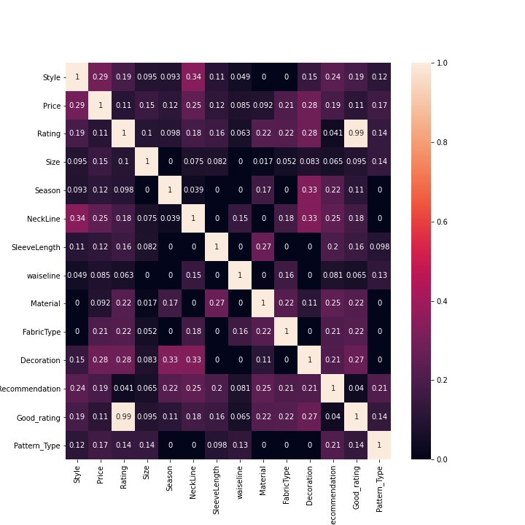
CORRELATION HEATMAP
Here we have represented the correlation between attributes using heatmap. Intensity of single cell depends on the value of correlation.

Slide 9
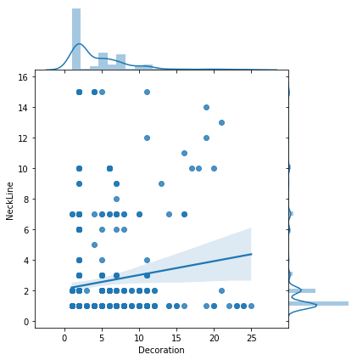
VIEWING CORRELATION BETWEEN ATTRIBUTES
From the correlation heatmap we can get the most dependent pairs of attributes and plot them to view their correlation.
Here we have chosen ‘Decoration’ and ‘NeckLine’

Slide 10
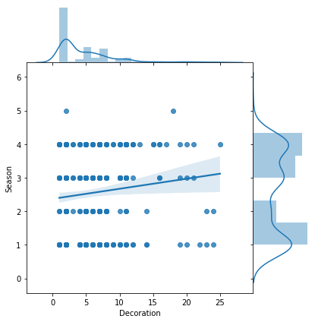
VIEWING CORRELATION BETWEEN ATTRIBUTES
From the correlation heatmap we can get the most dependent pairs of attributes and plot them to view their correlation.
Here we have chosen ‘Decoration’ and ‘Season’

Slide 11
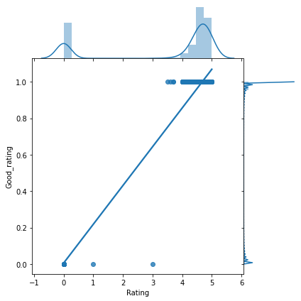
VIEWING CORRELATION BETWEEN ATTRIBUTES
From the correlation heatmap we can get the most dependent pairs of attributes and plot them to view their correlation.
Here we have chosen ‘Rating’ and ‘Good_rating’

Slide 12
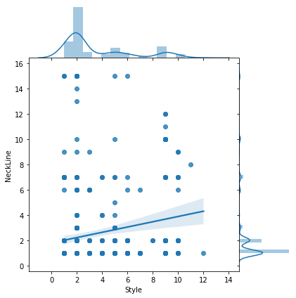
VIEWING CORRELATION BETWEEN ATTRIBUTES
From the correlation heatmap we can get the most dependent pairs of attributes and plot them to view their correlation.
Here we have chosen ‘Style’ and ‘NeckLine’

Slide 13
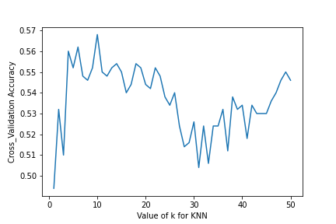
KNN CLASSIFICATION
In k-NN classification, the output is a class membership. An object is classified by a plurality vote of its neighbors, with the object being assigned to the class most common among its k nearest neighbors (k is a positive integer, typically small). If k = 1, then the object is simply assigned to the class of that single nearest neighbor.
So we have performed the algorithm for k=1 to k=50 and here are the results of accuracy.
**Max accuracy is 0.568 and is at k=9

Slide 14
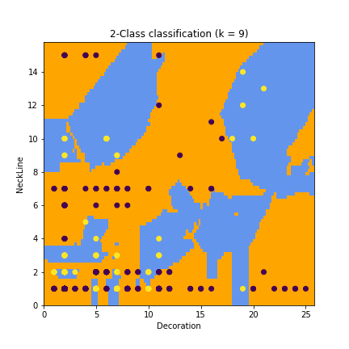
2-CLASS CLASSIFICATION
We can get the pairs of attribute from the correlation heatmap and perform classification and we can see how classification works.
Here we have chosen ‘Decoration’ and ‘NeckLine’.

Slide 15
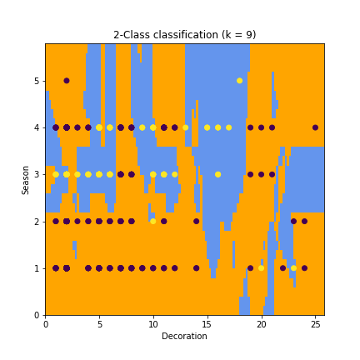
2-CLASS CLASSIFICATION
We can get the pairs of attribute from the correlation heatmap and perform classification and we can see how classification works.
Here we have chosen ‘Decoration’ and ‘Season’.

Slide 16
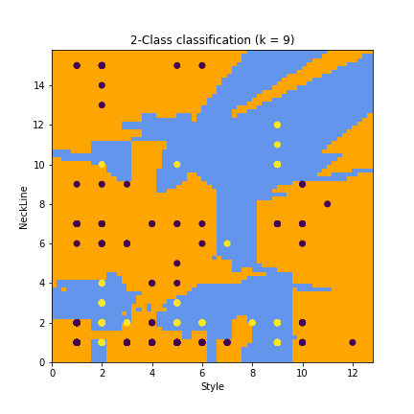
2-CLASS CLASSIFICATION
We can get the pairs of attribute from the correlation heatmap and perform classification and we can see how classification works.
Here we have chosen ‘Style’ and ‘NeckLine’.

Slide 17
CONCLUSION Here we performed knn classifier and we got the accuracy of 0.6. And we found the correlation between various attributes of the data set and found that some of the attributes were slightly dependent but otherwise it was totally independent.
THANK YOU

